Slide 1
Serverless Lambda function with API Gateway

Slide 2
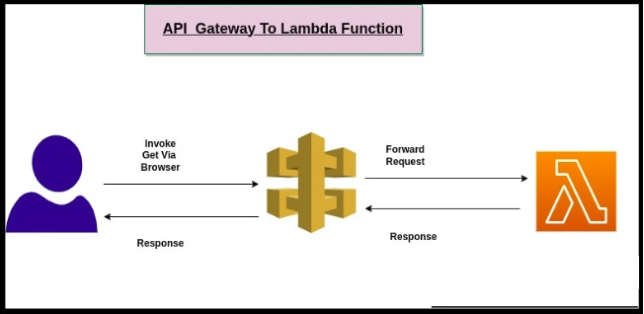

Slide 3
What is lambda ?
AWS Lambda is an AWS service that is responsible for running particular functions in response to particular triggers — events happening in the application. AWS Lambda is a compute service that lets you run code without provisioning or managing servers.
Lambda runs your code on a high-availability compute infrastructure and performs all of the administration of the compute resources, including server and operating system maintenance, capacity provisioning and automatic scaling, and logging. With Lambda, all you need to do is supply your code in one of the language runtimes that Lambda supports.
You organize your code into Lambda functions. The Lambda service runs your function only when needed and scales automatically. You only pay for the compute time that you consume—there is no charge when your code is not running.

Slide 4
When to use Lambda ?
Lambda is an ideal compute service for application scenarios that need to scale up rapidly, and scale down to zero when not in demand. For example, you can use Lambda for:
File processing: Use Amazon Simple Storage Service (Amazon S3) to trigger Lambda data processing in real time after an upload.
Stream processing: Use Lambda and Amazon Kinesis to process real-time streaming data for application activity tracking, transaction order processing, clickstream analysis, data cleansing, log filtering, indexing, social media analysis, Internet of Things (IoT) device data telemetry, and metering.
Web applications: Combine Lambda with other AWS services to build powerful web applications that automatically scale up and down and run in a highly available configuration across multiple data centers.
IoT backends: Build serverless backends using Lambda to handle web, mobile, IoT, and third-party API requests.
Mobile backends: Build backends using Lambda and Amazon API Gateway to authenticate and process API requests. Use AWS Amplify to easily integrate with your iOS, Android, Web, and React Native frontends.

Slide 5
Lambda runs instances of your function to process events. You can invoke your function directly using the Lambda API, or you can configure an AWS service or resource to invoke your function.
Function
A function is a resource that you can invoke to run your code in Lambda. A function has code to process the events that you pass into the function or that other AWS services send to the function.
Trigger
A trigger is a resource or configuration that invokes a Lambda function. Triggers include AWS services that you can configure to invoke a function and event source mappings. An event source mapping is a resource in Lambda that reads items from a stream or queue and invokes a function. For more information, see Invoking Lambda functions and Using AWS Lambda with other services.
Event
An event is a JSON-formatted document that contains data for a Lambda function to process. The runtime converts the event to an object and passes it to your function code. When you invoke a function, you determine the structure and contents of the event.

Slide 6
What is layers in Lambda function?
A Lambda Layer works very similarly to a folder containing a library in a function code. The difference is that, instead of having to package this library within the function code, it can be packaged separately. Lambda will load the Layer together with the function when it’s invoked.
For a Lambda function, there is a maximum of 5 layers and a maximum size for all layers of 250 MB (uncompressed). This maximum applies regardless of whether you are using an official AWS runtime or a custom runtime.

Slide 7
What Is an API Gateway and Why use an API gateway?
An API gateway is an API management tool that sits between a client and a collection of backend services.
An API gateway acts as a reverse proxy to accept all application programming interface (API) calls, aggregate the various services required to fulfill them, and return the appropriate result.
You can use API Gateway WebSocket APIs to build secure, real-time communication applications without having to provision or manage any servers to manage connections or large-scale data exchanges. Targeted use cases include real-time applications such as the following:
Chat applications
Real-time dashboards such as stock tickers
Real-time alerts and notifications

Slide 8
How do APIs work?
APIs let your product or service communicate with other products and services without having to know how they’re implemented. This can simplify app development, saving time and money. When you’re designing new tools and products—or managing existing ones—APIs give you flexibility; simplify design, administration, and use; and provide opportunities for innovation.
APIs are sometimes thought of as contracts, with documentation that represents an agreement between parties: If party 1 sends a remote request structured a particular way, this is how party 2’s software will respond.
Because APIs simplify how developers integrate new application components into an existing architecture, they help business and IT teams collaborate. Business needs often change quickly in response to ever shifting digital markets, where new competitors can change a whole industry with a new app. In order to stay competitive, it's important to support the rapid development and deployment of innovative services. Cloud-native application development is an identifiable way to increase development speed, and it relies on connecting a microservices application architecture through APIs.
APIs are a simplified way to connect your own infrastructure through cloud-native app development, but they also allow you to share your data with customers and other external users. Public APIs represent unique business value because they can simplify and expand how you connect with your partners, as well as potentially monetize your data (the Google Maps API is a popular example).
Chart of how APIs work: Backend systems connect to APIs, which connect to an API management system, which connect to Apps, IoT devices and mobile.
Letting customers access data via an API helps them aggregate information about their inventory in a single place.
In short, APIs let you open up access to your resources while maintaining security and control. How you open access and to whom is up to you. API security is all about good API management, which includes the use of an API gateway. Connecting to APIs, and creating applications that consume the data or functionality exposed by APIs, can be done with a distributed integration platform that connects everything—including legacy systems, and the Internet of Things (IoT).

Slide 9
API Gateway Capabilities and Benefits
API gateways commonly implement capabilities that include:
Security policy – Authentication, authorization, access control, and encryption
Routing policy – Routing, rate limiting, request/response manipulation, circuit breaker, blue-green and canary deployments, A/B testing, load balancing, health checks, and custom error handling
Observability policy – Real-time and historical metrics, logging, and tracing
For additional app- and API-level security, API gateways can be augmented with web application firewall (WAF) and denial of service (DoS) protection.
Deploying an API gateway for app delivery can help:
Reduce complexity and speed up app releases by encapsulating the internal application architecture and providing APIs tailored for each client type
Streamline and simplify request processing and policy enforcement by centralizing the point of control and offloading non-functional requirements to the infrastructure layer
Simplify troubleshooting with granular real-time and historical metrics and dashboards

Slide 10
API Gateway Endpoint Types
An API endpoint type is a hostname for an API in API Gateway that is deployed to a specific region.
The hostname is of the form {api-id}.execute-api.{region}.amazonaws.com.
The API endpoint type can be edge-optimized, regional, or private, depending on where most of your API traffic originates from.

Slide 11
Edge-Optimized Endpoint
An edge-optimized API endpoint is best for geographically distributed clients. API requests are routed to the nearest CloudFront Point of Presence (POP). This is the default endpoint type for API Gateway REST APIs.
Edge-optimized APIs capitalize the names of HTTP headers (for example, Cookie).
CloudFront sorts HTTP cookies in natural order by cookie name before forwarding the request to your origin. For more information about the way CloudFront processes cookies, see Caching Content Based on Cookies.
Any custom domain name that you use for an edge-optimized API applies across all regions.

Slide 12
Regional Endpoint
A regional API endpoint is intended for clients in the same region.
When a client running on an EC2 instance calls an API in the same region, or when an API is intended to serve a small number of clients with high demands, a regional API reduces connection overhead.
For a regional API, any custom domain name that you use is specific to the region where the API is deployed.
If you deploy a regional API in multiple regions, it can have the same custom domain name in all regions.
You can use custom domains together with Amazon Route 53 to perform tasks such as latency-based routing.
Regional API endpoints pass all header names through as-is.

Slide 13
Private Endpoint
A private API endpoint is an API endpoint that can only be accessed from your Amazon Virtual Private Cloud (VPC) using an interface VPC endpoint, which is an endpoint network interface (ENI) that you create in your VPC.
Private API endpoints pass all header names through as-is.

Slide 14
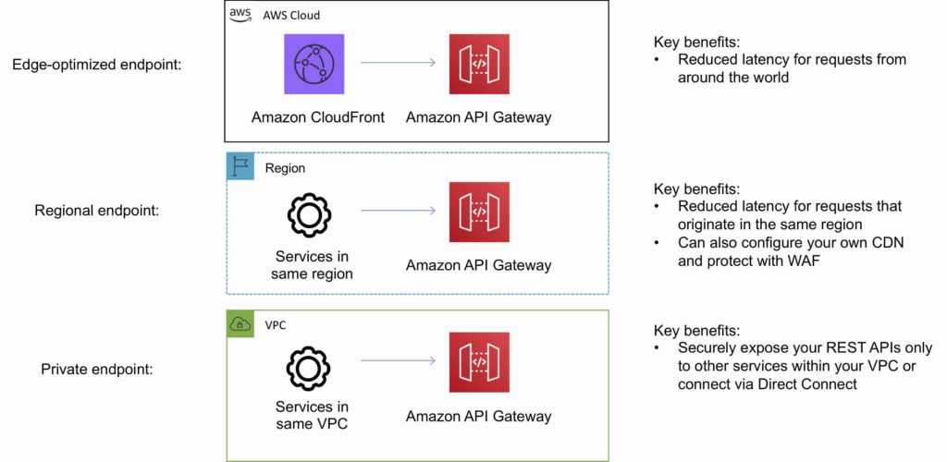

Slide 15
Resources
A resource-oriented API is generally modeled as a resource sequence, where each node is either a simple resource or a collection resource. For convenience, they are often called a resource and a collection.
A collection contains a list of resources of the same type. For example, a user has a collection of contacts.
A resource has some state and zero or more sub-resources. Each sub-resource can be either a simple resource or a collection resource.
For example, Gmail API has a collection of users, each user has a collection of messages, a collection of threads, a collection of labels, a profile resource, and several setting resources.
While there is some conceptual alignment between storage systems and REST APIs, a service with a resource-oriented API is not necessarily a database, and has enormous flexibility in how it interprets resources and methods. For example, creating a calendar event (resource) may create additional events for attendees, send email invitations to attendees, reserve conference rooms, and update video conference schedules.

Slide 16
Methods
The key characteristic of a resource-oriented API is that it emphasizes resources (data model) over the methods performed on the resources (functionality). A typical resource-oriented API exposes a large number of resources with a small number of methods. The methods can be either the standard methods or custom methods. For this guide, the standard methods are: List, Get, Create, Update, and Delete.
Where API functionality naturally maps to one of the standard methods, that method should be used in the API design. For functionality that does not naturally map to one of the standard methods, custom methods may be used.

Slide 17
The 5 essential HTTP methods in RESTful API development

Slide 18
The primary or most commonly-used HTTP methods are POST, GET, PUT, PATCH, and DELETE. These methods correspond to create, read, update, and delete (or CRUD) operations, respectively. There are a number of other methods, too, but they are utilized less frequently.
GET Method
If we want to retrieve data from a resource like websites, servers or APIs, we send them a GET Request. For example, we send a GET request to the server if we want a list of our customers or a specific customer.
Since the GET method should never change the data on the resources and just read them(read-only), it is considered a Safe Method. Additionally, the Get method is idempotent.
POST Method
The POST method creates a new resource on the backend (server). The request body carries the data we want to the server. It is neither a safe nor idempotent method. We don’t expect to get the same result every time we send a POST request. For example, two identical POST requests will create two new equivalent resources with the same data and different resource ids.
PUT Method
With the PUT request method, we can update an existing resource by sending the updated data as the content of the request body to the server. The PUT method updates a resource by replacing its entire content completely. If it applies to a collection of resources, it replaces the whole collection, so be careful using it. The server will return the 200 or 204 status codes after the existing resource is updated successfully.
PATCH Method
PATCH is another HTTP method that is not commonly used. Similar to PUT, PATCH updates a resource, but it updates data partially and not entirely. For example, to make it more precise, the request [PUT] customers/{customerid} would update the fields in the Customers entity on the resource entirely. However, the PATCH method does update the provided fields of the customer entity. In general, this modification should be in a standard format like JSON or XML.
DELETE Method
As the name suggests, the DELETE method deletes a resource. The DELETE method is idempotent; regardless of the number of calls, it returns the same result.
Most APIs always return the 200 status code even if we try to delete a deleted resource but in some APIs, If the target data no longer exists, the method call would return a 404 status code.

Slide 19
Method | Summary | CRUD | Accepts Request Body | Safe
GET | To fetch a single resource or group of resources | Read | No | Yes
PUT | To update an entire resource in one go | Update | Yes | No
POST | To create a new resource | Create | Yes | No
PATCH | To partially update a resource | Update | Yes | No
DELETE | To delete a resource | Delete | No | No
OPTIONS | To get information on permitted operations | Read | No | Yes
HEAD | To get metadata of the endpoint | Read | No | Yes
TRACE | For diagnosing purposes | Read | No | Yes
CONNECT | To make the two-way connection between the client and the resource. | - | No | No

Slide 20
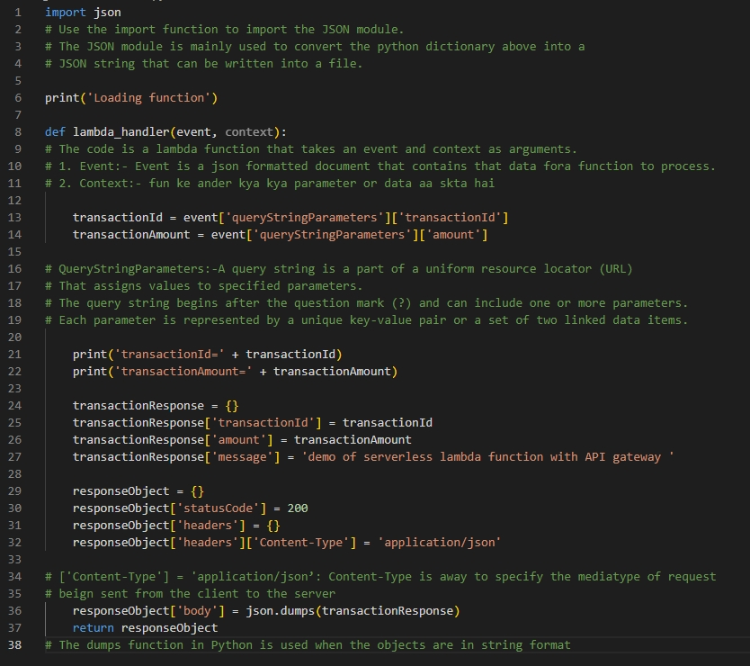

Slide 21
Code Explanation
The lambda_handler function is a Python function that is used as an AWS Lambda function. The function takes two arguments: an event object and a context object. The event object contains information about the event that triggered the Lambda function, and the context object contains information about the execution environment of the Lambda function.
The function first parses out the transactionId and transactionAmount query string parameters from the event object. It then constructs a transactionResponse dictionary object that contains the transactionId, amount, and message keys. The transactionId and amount values are set to the values parsed from the query string parameters, and the message value is set to a demo message.
The function then constructs an HTTP response object by creating a responseObject dictionary object. The statusCode key is set to 200, indicating a successful response. The headers key is set to an empty dictionary, and the Content-Type header is set to application/json. The body key is set to a JSON string representation of the transactionResponse dictionary object.
Finally, the function returns the responseObject dictionary object as the response to the Lambda function invocation.

Slide 22
questions
What is REST?
Ans: REST (Representational State Transfer) is a design pattern for creating web services. It establishes a set of constraints and principles for creating web APIs that are flexible, scalable, and simple to maintain.
What is the difference between REST and RESTful?
Ans: REST is a set of architectural guidelines for building APIs. RESTful APIs are APIs that adhere to REST guidelines.
What is the difference between RESTful and Non-Restful APIs?
Ans: RESTful APIs follow REST guidelines. On the contrary, Non-Restful APIs use other methods/protocols like SOAP(Simple Object Access Protocol) for communication.

Slide 23
questions
What is the difference between POST and PUT?
The PUT method modifies an existing resource, but the POST HTTP method creates a new resource. Therefore, the PUT method is safe and idempotent, while the POST method is neither safe nor idempotent.
What is the difference between PUT and PATCH?
The PUT method updates the resource by replacing the whole data, while the PATCH method partially updates the resource. Thus, The PUT method is safe and idempotent, but the PATCH method is neither safe nor idempotent.
Does the GET method accept the request body?
Requests using the GET methods should only be for fetching data, not carrying it, so it is better to avoid sending data loads to the server as it causes an error if the server doesn’t accept it. However, the specifications don’t prohibit it.

